Slide 1
BSC PROJECT
MEG DATA ANALYSIS
LILLY CUTAIA

Slide 2
DATA DESCRIPTION
The subject is a yoga teacher performing breathing exercises for the treatment of obsessive-compulsive disorder;
Six sessions recorded over a three-month time period, 51 minutes per session;
For odd datasets the exercise was performed with the left nostril;
For even datasets the exercise was performed with the right nostril;
148 channels distributed all over the head, the signal was taken with a sampling frequency of 254.31 Hz.
For this project data from Dataset 6 were analyzed: minute 10 (rest phase I), from minute 32 to 35 (exercise phase), minute 51 (rest phase II).
YOGIC PROTOCOL
Rest phase I: from minute 0 to 10;
Exercise phase: from minute 11 to 42;
Rest phase II: from minute 43 to 53;
FOR EACH MINUTE OF THE EXERCISE PHASE:
Inspiration phase: 15 s;
Breath retention: 15 s;
Slow expiration: 15 s;
Breath held out: 15 s.

Slide 3
STANDARD ANALYSIS PROCEDURE
Data were filtered in gamma band (32-50 Hz) since it’s more suitable to examine this case of study: in fact, gamma band contains frequencies that characterize an intense mental activity and let us understand the lateralization of the brain.
The two rest phases were analyzed separately, while for the exercise phases minute-by-minute analyzes were performed together with an overall analysis over the signal trend.
The two brain’s hemispheres were analyzed separately to see what part of the brain was mostly used for each phase.
Analysis of channel 96, that was the origin of the breathing stimulus.

Slide 4
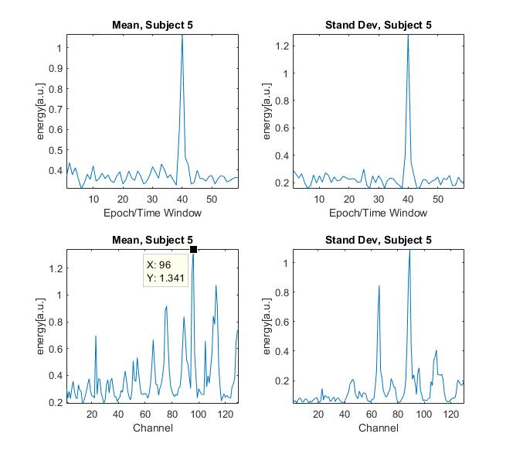
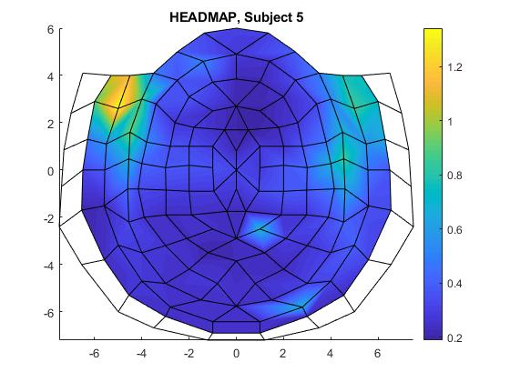
REST PHASE I ANALYSIS
Analyzing in the time domain we can see high frequency peaks on the second 40. Considering the fact that we are not in an exercise phase, it is not clear what this energy peak could be due to. We know, however, that it comes from channels 88 and 89.
The activity is mainly concentrated in the left hemisphere, in particular stimulus come from channel 96, in the left hemisphere.

Slide 5
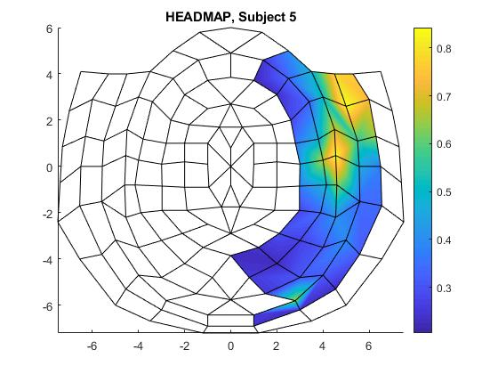
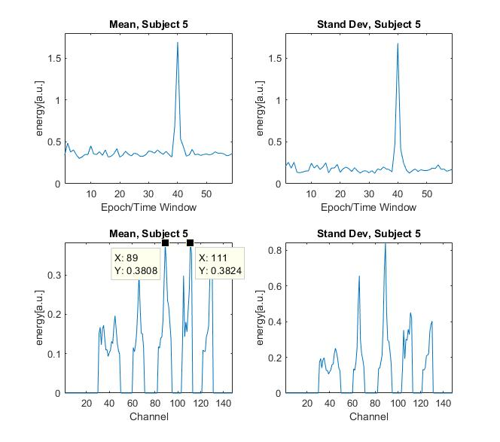
REST PHASE I ANALYSIS: RIGHT HEMISPHERE
As said before, the spike at the second 40 comes from the right emisphere, in particular from channel 88 and 89. Unfortunately, we don’t know if it’s an artifact or another kind of activity because in this phase the subject wasn’t following any kind of breathing protocol.
Also the channel 111 seems to be a source of a stimulus.

Slide 6
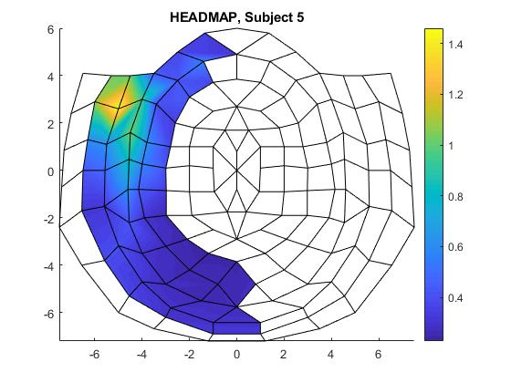
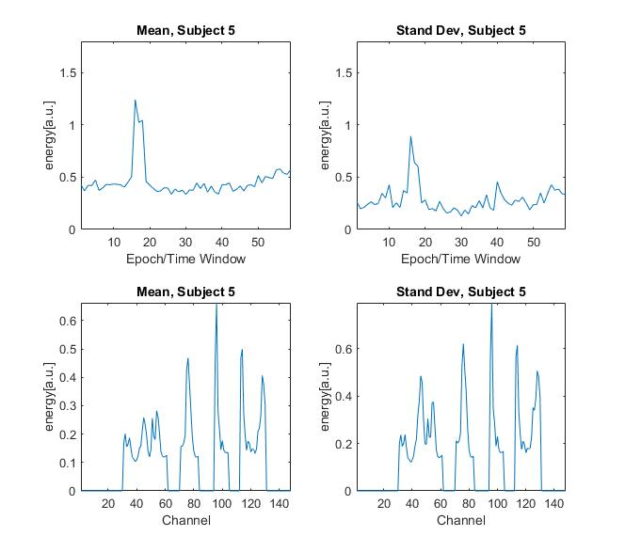
REST PHASE I ANALYSIS: LEFT HEMISPHERE
We notice a much more regular trend over time, but from the point of view of the channels it’s easy to understand from which channel the impulse comes: on channel 96 we find a peak of energy, so we found the source of the stimulus for this hemisphere.
Considering that this channel has an average energy of 0.6 millivolts for a minute, we can say that this is certainly the most active area of ​​the brain at this stage.

Slide 7
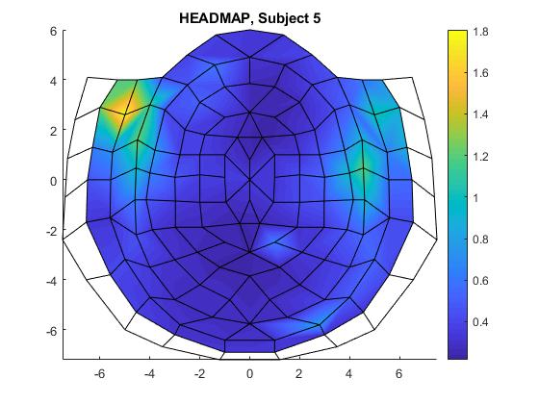
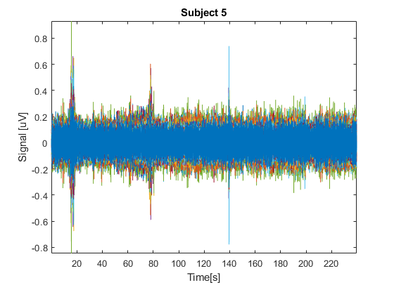
EXERCISE PHASE ANALYSIS
First of all there’s an analysis of all the consecutive exercise minutes from both hemispheres, just to get an overview of what happens in this phase.
The energy peaks will be discussed later.

Slide 8
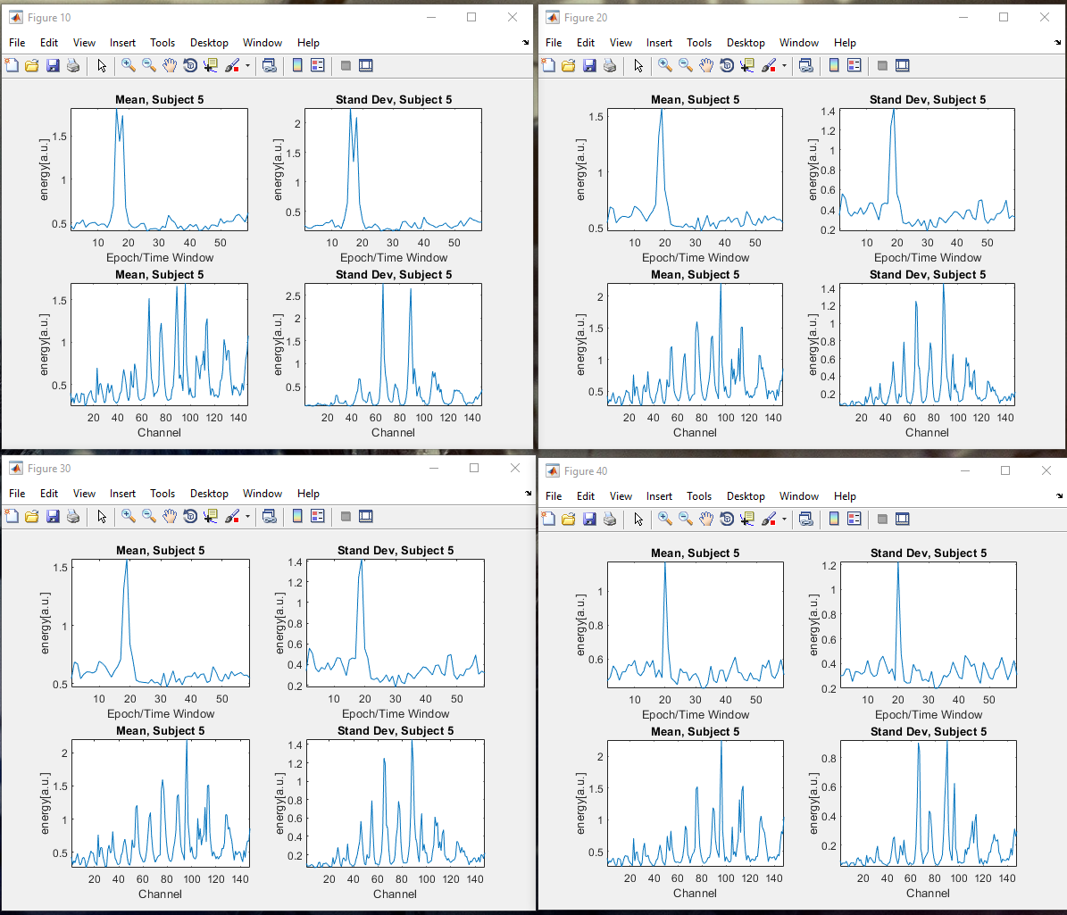
EXERCISE PHASE: MINUTE BY MINUTE ANALYSIS
As we can see from the graphs, in all the time intervals taken into consideration we see peaks of energy around the second 20. This, according to the protocol, is the phase in which the subject holds his breath. We can also see how the signal pulse is always generated from the same area, so the impulse always comes from the same channels.
Therefore, the subject concentrates more in the phase in which he must hold his breath than the other phases: this can be proved by the fact that we have same peaks with the same intensity in each dataset and in the same time windows.

Slide 9
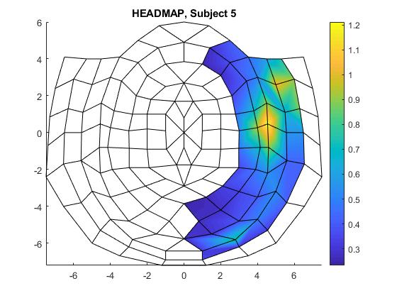
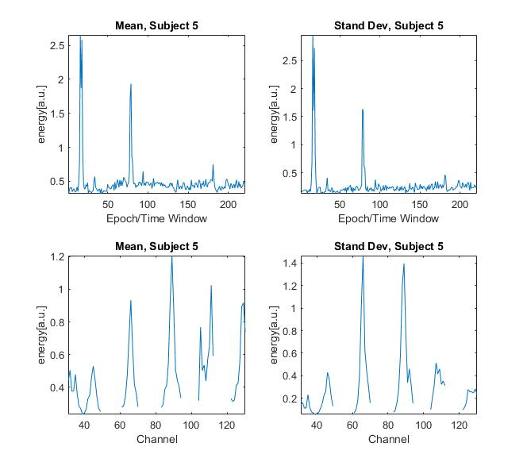
EXERCISE PHASE: RIGHT HEMISPHERE ANALYSIS
As we can see, even in this phase the activity is concentrated in channel 89.
Apparently, the activity is not periodic.

Slide 10

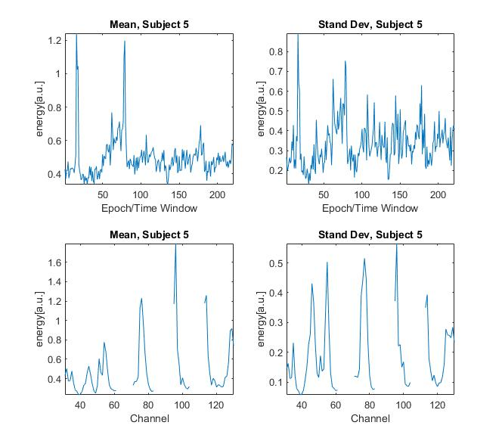
EXERCISE PHASE: LEFT HEMISPHERE ANALYSIS
In this phase the activity is mostly concentrated in channel 96.
Also in this situation the activity seems not to be periodic.
It’s easy to recognize a similarity between the graphs for left and right hemisphere, thus we can see the same energy peaks in the same time windows.
That means that even if the activity was concentrated mainly in one part of the brain, the specular part acts in a similar way, however producing a stimulus of lower amplitude.

Slide 11
CHANNEL 96 ANALYSIS (LEFT HEMISPHERE)
By studying the signal on this channel, it should be possible to see the periodicities that indicate the different phases of exercise, separated by the two rest phases. As we can see, for each phase we find a periodicity of the signal: the seconds multiples of 60, in which the exercise takes place, all present the same peaks in the same moments, so we can easily distinguish the various phases.
At the beginning of the exercise, in the first phase of inspiration, we find very low energy peaks, around 0.08 millivolts;
The breath retention phase stands out because the energy peaks are much higher, in the order of 0.2 millivolts;
For the slow expiration phase, the peak is in the order of 0.14 millivolts;
In the breath held out phase the concentration is maximum: we touch peaks of 0.25 millivolts. The trend described above is repeated every 60 seconds and makes it easy to distinguish the various phases. It means that the subject always has the same level of concentration throughout the exercise. If this were not the case, the signal would not have been periodic in this band.

Slide 12
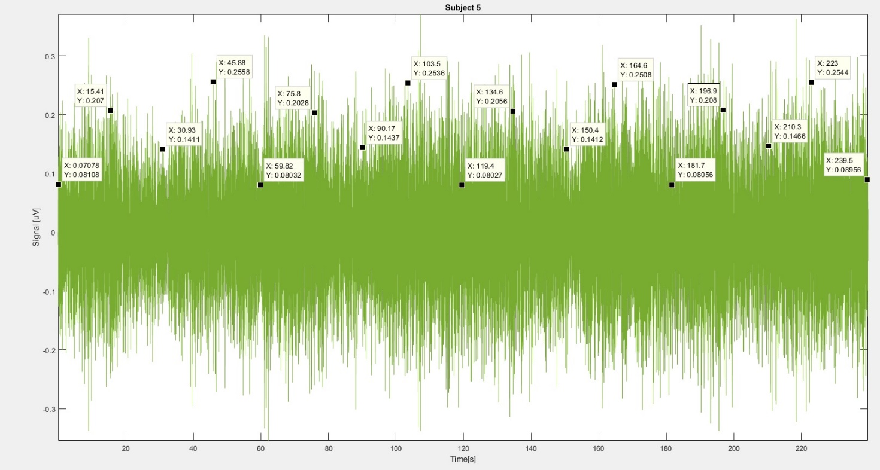
CHANNEL 96 ANALYSIS (LEFT HEMISPHERE)
As said before, here a pattern in the all phases can be recognized.

Slide 13
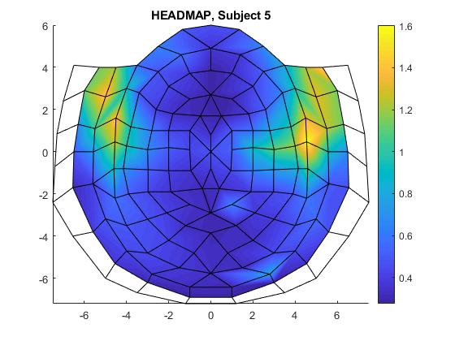
REST PHASE II ANALYSIS
In this phase the subject is breathing normally.
The activity between the two parts of the brain is quite simmetric, it means that in this case we don’t have lateralization: the stimulus comes from both parts of the brain.

Slide 14
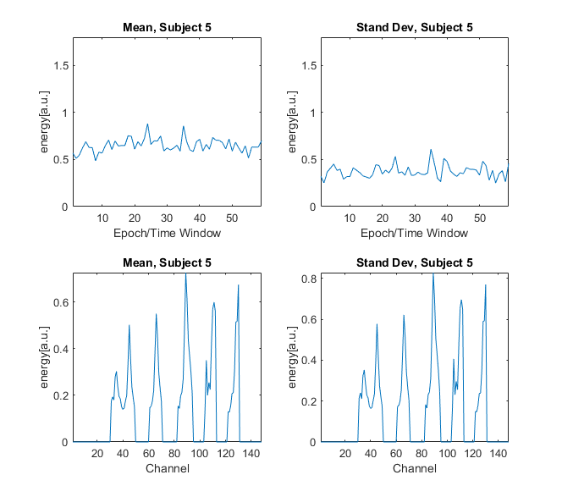
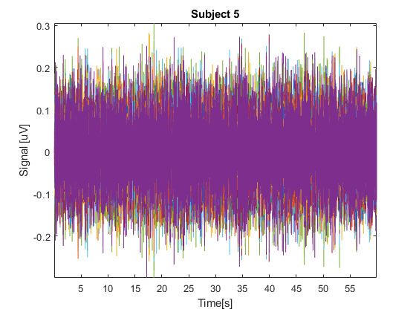

REST PHASE II ANALYSIS: RIGHT HEMISPHERE
The slope of the signal in this hemisphere is very regular, without big energy spikes in the time interval.
Also in this situation the stimulus comes from channel 89.

Slide 15
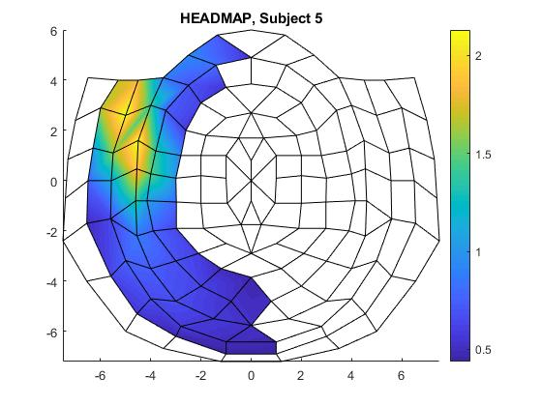
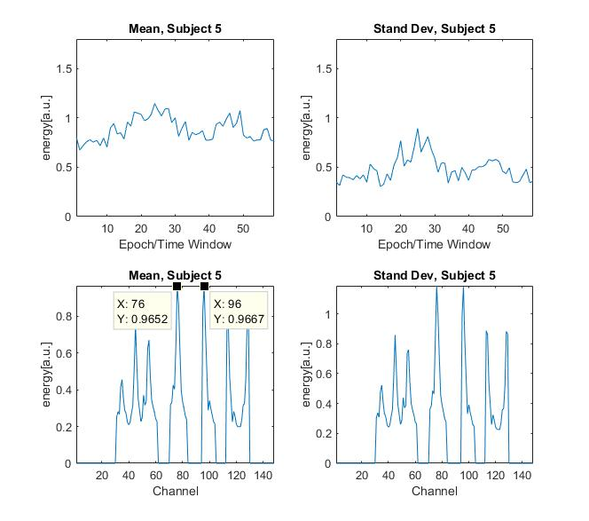
REST PHASE II ANALYSIS: LEFT HEMISPHERE
Also here the respiratory activity is quite regular.
The impulse comes from channel 76 and 96
In particular, channel 96 was the one from which the impulse used to start in exercise phase.

Slide 16
ANALYSIS RESULTS
The Rest Phase I Dataset records the last minute of rest before the exercise started.
Probably we find an asymmetry in the use of the brain because the subject was preparing to perform the exercise with just the right nostril, hence the obvious lateralization.
During the exercise the subject breathe only with the right nostril: this is why the impulse comes from the left side, since the right part of the body refers to the left hemisphere of the brain and viceversa.
The dataset related to the Rest Phase II instead registers a generic minute of rest.
Here there’s no lateralization, indeed we find an almost perfect symmetry between the two hemispheres, a sign that the subject, probably tired, was surely breathing with both nostrils open: the initial concentration failed, the two parts of the body were working together, also the brain.
This shows that during the breathing exercises performed in situations of deep concentration, the same areas of the brain are always activated for both hemispheres, which work in a specular way.
These results are true only for the Gamma band. We could perform an analysis in the other bands to see what’s possible to find out in the same conditions.

Slide 17
ADVANCED ANALYSIS PROCEDURE
As advanced analysis procedure the DFA analysis was chosen.
The analysis was performed on a period of 3 minutes excersise.
The focus will be on channel 96 as the source of the breathing stimulus.
Our step is very small (step=10) so we can highlight the high frequencies. Since DFA is an analysis that relates signal to noise, so the signal is not filtered in any band.

Slide 18
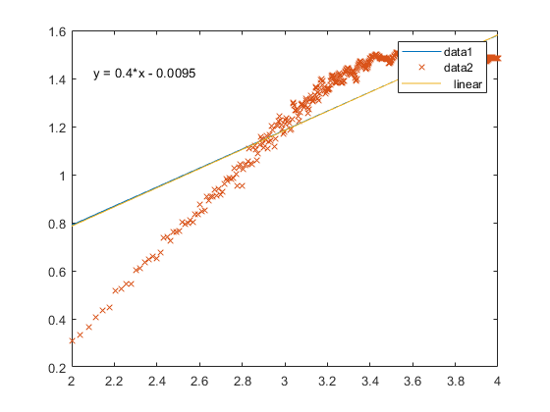
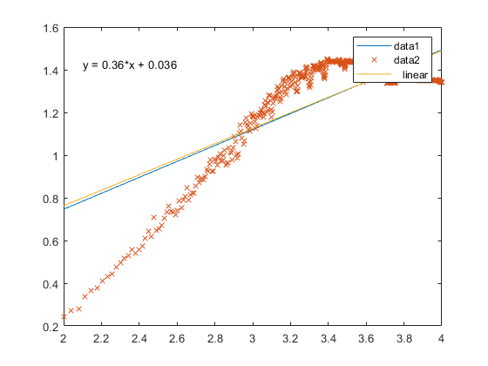
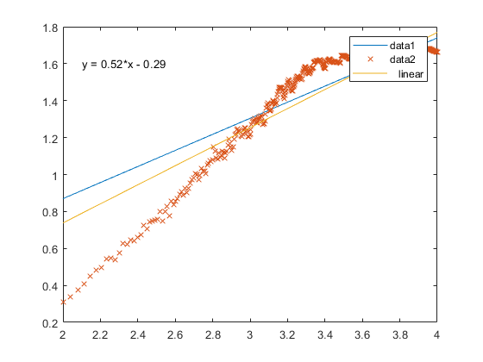
DFA ANALYSIS
We chose an high number of samples so we can see if the signal is correlated. By taking these parameters:
Start=100;
Step=10;
Ende=10000.
It’s possible to obtain these values of a (angular coefficient):
For minute 33 a=0.4;
For minute 34 a=0.36;
For minute 35 a=0.52.
For minute 33 and 34 the signal seems to be not correlated, for minute 35 it’s barely correlated.
Tha analysis didn’t produce a reliable result choosing these parameters.

Slide 19
DFA ANALYSIS
Since DFA analysis is reliable only when a line that best fits the data is found, parameters were changed and the analysis was performed again.
This trend was found changing the parameters as following:
Start=30;
Step=10;
Ende=3000.
In this way we have less samples that best fit the line.
As made before, we kept a step=10 because a small step highlights high frequencies. The channel 96 is the most active for gamma band, so we need to focus on an high frequency signal.

Slide 20
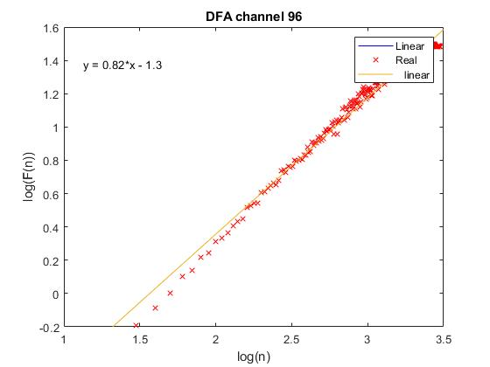
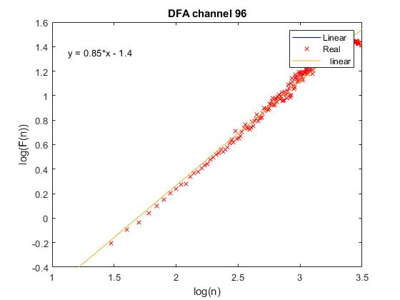
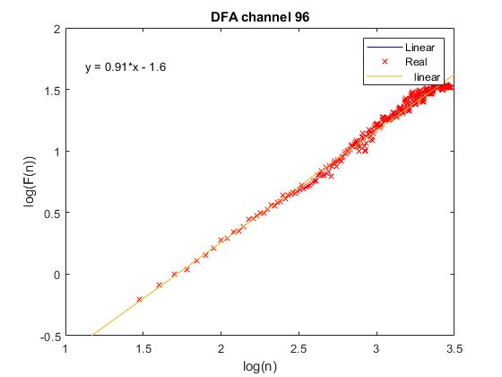
DFA ANALYSIS
As can be seen, this analysis is quite reliable, even if we have less samples than we had before.
With an angular coeffient value respectively equal to:
A=0.82 for minute 33;
A=0.85 for minute 34;
A=0.91 for minute 35;
It’s possible to say that the signal is correlated on channel 96 for all the data we have considered.

Slide 21

THANKS FOR THE ATTENTION!

